Slide 1
Chapter 8
How to transfer data from controllers

Slide 2
Objectives (part 1)
Applied
Use the ViewBag and ViewData properties to transfer data from a controller to a view.
Use a view model to transfer data from a controller to a strongly-typed view.
Develop web apps that redirect and use the TempData property to transfer data from a controller to a controller.

Slide 3
Objectives (part 2)
Knowledge
Describe some important interfaces and classes of the ActionResult hierarchy.
Distinguish between the ViewBag and ViewData properties.
Describe the use of a view model to transfer data from a controller to a view.
Describe how one action method can redirect to another action method.
Describe the use of the PRG pattern to prevent resubmission of POST data.
Distinguish between the ViewData and TempData properties.
Describe the purpose of the Keep() and Peek() methods of the TempData class.

Slide 4
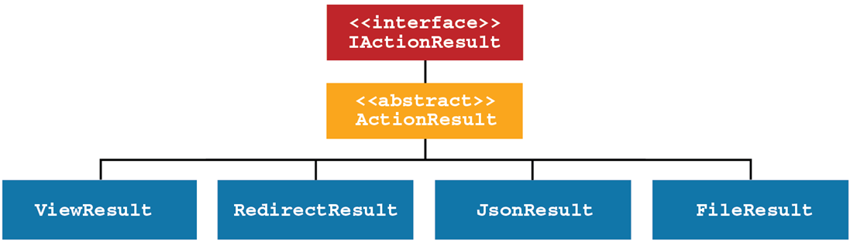
The ActionResult hierarchy

Slide 5
Common ActionResult subtypes
ViewResult
RedirectResult
RedirectToActionResult
JsonResult
FileResult
StatusCodeResult
ContentResult
EmptyResult
A URL for a full list of the ActionResult subtypes
https://docs.microsoft.com/en-us/dotnet/api/
microsoft.aspnetcore.mvc.actionresult

Slide 6
Some methods of the Controller class that return an ActionResult object
View()
Redirect()
RedirectToAction()
File()
Json()
Some of the overloads of the View() method
View()
View(model)
View(name)
View(name, model)

Slide 7
An action method that returns a ViewResult object
public ViewResult List() {
var names = new List<string> { "Grace", "Ada", "Charles" };
return View(names);
}
An action method that returns a RedirectToActionResult object
public RedirectToActionResult Index() =>
RedirectToAction("List");
An action method that may return different types of result objects
[HttpPost]
public IActionResult Edit(string id) {
if (ModelState.IsValid)
return RedirectToAction("List");
else
return View((object)id); // cast string model to object
}

Slide 8
Controller code that adds two items to the ViewData property
public ViewResult Index() {
ViewData["Book"] = "Alice in Wonderland";
ViewData["Price"] = 9.99;
return View();
}

Slide 9
Some properties of the ViewDataDictionary class
Count
Keys
Values

Slide 10
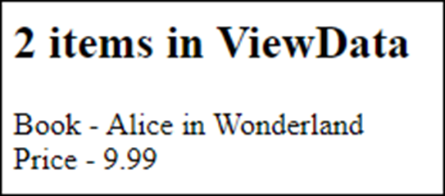
Razor code that displays all the items in the ViewData object
<h2>@ViewData.Count items in ViewData</h2>
@foreach (KeyValuePair<string, object> item in ViewData) {
<div>@item.Key - @item.Value</div>
}
The view in the browser

Slide 11

Razor code that casts a ViewData object to the double type
<h4>Price: @(((double)ViewData["Price"]).ToString("c"))</h4>
The view in the browser

Slide 12
Razor code that checks ViewData values for null
Non-nullable type (double)
<h4>Price: @((ViewData["Price"] == null) ? "" :
((double)ViewData["Price"]).ToString("c"))</h4>
Nullable type (string)
<h4>Book: @ViewData["Book"]?.ToString()</h4>

Slide 13
Controller code that adds two dynamic properties to the ViewBag property
public ViewResult Index() {
ViewBag.Book = "Alice in Wonderland";
ViewBag.Price = 9.99;
return View();
}

Slide 14
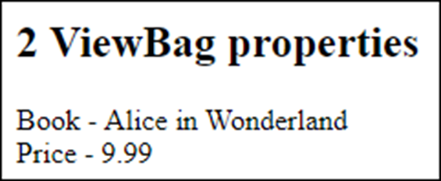
Razor code that uses ViewData to display ViewBag properties
<h2>@ViewData.Count ViewBag properties</h2>
@foreach (KeyValuePair<string, object> item in ViewData) {
<div>@item.Key - @item.Value</div>
}
The view in the browser

Slide 15
Razor code that works with a ViewBag property without casting
<h4>Price: @ViewBag.Price.ToString("c")</h4>
The view in the browser

Slide 16
Razor code that checks ViewBag properties for null
Non-nullable type (double)
<h4>Price: @ViewBag.Price?.ToString("c")</h4>
Nullable type (string)
<h4>Book: @ViewBag.Book?.ToString()</h4>

Slide 17
Use ViewData instead of ViewBag when you need to…
Use a key name that isn’t valid in C#, such as a key that contains spaces.
Call properties and methods of the ViewDataDictionary class, such as its Count property or its Clear() method.
Loop through all items in the ViewData dictionary.

Slide 18
How the teams of the NFL are organized
There are two conferences, the NFC and the AFC.
Each conference contains four divisions named North, South, East, and West.
Each division contains four teams.

Slide 19
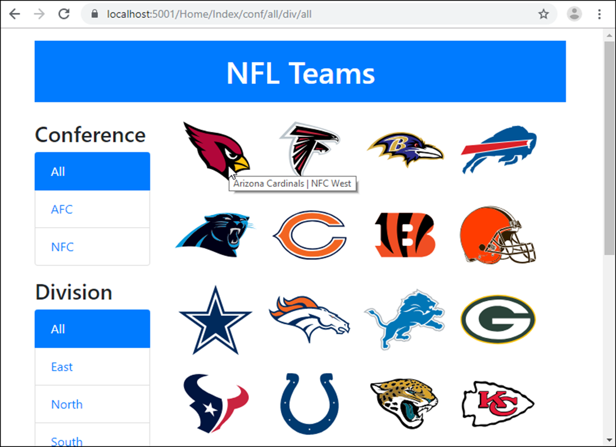
The NFL Teams app on first load

Slide 20
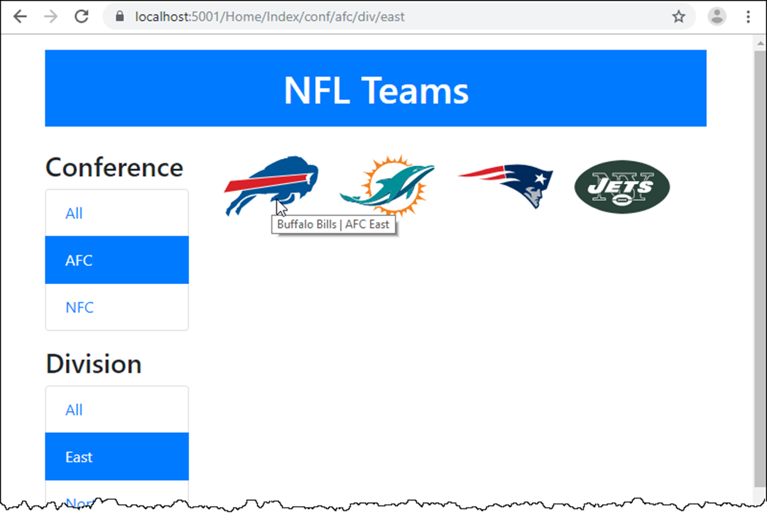
The NFL Teams app after a conference and division are selected

Slide 21
The Conference class
public class Conference
{
public string ConferenceID { get; set; }
public string Name { get; set; }
}
The Division class
public class Division
{
public string DivisionID { get; set; }
public string Name { get; set; }
}
The Team class
public class Team
{
public string TeamID { get; set; }
public string Name { get; set; }
public Conference Conference { get; set; }
public Division Division { get; set; }
public string LogoImage { get; set; }
}

Slide 22
The TeamContext class (part 1)
public class TeamContext : DbContext
{
public TeamContext(DbContextOptions<TeamContext> options)
: base(options) { }
public DbSet<Team> Teams { get; set; }
public DbSet<Conference> Conferences { get; set; }
public DbSet<Division> Divisions { get; set; }
protected override void OnModelCreating(
ModelBuilder modelBuilder) {
base.OnModelCreating(modelBuilder);
modelBuilder.Entity<Conference>().HasData(
new Conference { ConferenceID = "afc", Name = "AFC"},
...
);
modelBuilder.Entity<Division>().HasData(
new Division { DivisionID = "north", Name = "North" },
...
);

Slide 23
The TeamContext class (part 2)
modelBuilder.Entity<Team>().HasData(
new {TeamID = "ari", Name = "Arizona Cardinals",
ConferenceID = "nfc", DivisionID = "west",
LogoImage = "ARI.png"},
...
);
}
}

Slide 24
The Home controller (part 1)
public class HomeController : Controller
{
private TeamContext context;
public HomeController(TeamContext ctx)
{
context = ctx;
}
public ViewResult Index(string activeConf = "all",
string activeDiv = "all")
{
// store selected conference and division IDs in view bag
ViewBag.ActiveConf = activeConf;
ViewBag.ActiveDiv = activeDiv;

Slide 25
The Home controller (part 2)
// get list of conferences and divisions from database
List<Conference> conferences = context.Conferences.ToList();
List<Division> divisions = context.Divisions.ToList();
// insert default "All" value at front of each list
conferences.Insert(0, new Conference { ConferenceID = "all",
Name = "All" });
divisions.Insert(0, new Division { DivisionID = "all",
Name = "All" });
// store lists in view bag
ViewBag.Conferences = conferences;
ViewBag.Divisions = divisions;

Slide 26
The Home controller (part 3)
// get teams - filter by conference and division
IQueryable<Team> query = context.Teams;
if (activeConf != "all")
query = query.Where(
t => t.Conference.ConferenceID.ToLower() ==
activeConf.ToLower());
if (activeDiv != "all")
query = query.Where(
t => t.Division.DivisionID.ToLower() ==
activeDiv.ToLower());
// pass teams to view as model
var teams = query.ToList();
return View(teams);
}
}

Slide 27
The custom route in the Startup.cs file
endpoints.MapControllerRoute(
name: "custom",
pattern:
"{controller}/{action}/conf/{activeConf}/div/{activeDiv}");
endpoints.MapControllerRoute(
name: "default",
pattern: "{controller=Home}/{action=Index}/{id?}");

Slide 28
The layout
<!DOCTYPE html>
<html>
<head>
<meta name="viewport" content="width=device-width" />
<link href="~/lib/bootstrap/dist/css/bootstrap.min.css"
rel="stylesheet" />
<link href="~/css/site.css" rel="stylesheet" />
<title>@ViewBag.Title</title>
</head>
<body>
<div class="container">
<header class="text-center text-white">
<h1 class="bg-primary mt-3 p-3">NFL Teams</h1>
</header>
<main>
@RenderBody()
</main>
</div>
</body>
</html>

Slide 29
The Home/Index view (NFL Teams 1.0) (part 1)
@model IEnumerable<Team>
@{
ViewData["Title"] = "NFL Teams";
string Active(string filter, string selected)
{
return (filter.ToLower() == selected.ToLower()) ?
"active" : "";
}
}
<div class="row">
<div class="col-sm-3">
<h3 class="mt-3">Conference</h3>
<div class="list-group">
@foreach (Conference conf in ViewBag.Conferences)
{
<a asp-action="Index"
asp-route-activeConf="@conf.ConferenceID"
asp-route-activeDiv="@ViewBag.ActiveDiv"
class="list-group-item @Active(conf.ConferenceID,
ViewBag.ActiveConf)">
@conf.Name
</a>
}
</div>

Slide 30
The Home/Index view (NFL Teams 1.0) (part 2)
<h3 class="mt-3">Division</h3>
<div class="list-group">
@foreach (Division div in ViewBag.Divisions)
{
<a asp-action="Index"
asp-route-activeConf="@ViewBag.ActiveConf"
asp-route-activeDiv="@div.DivisionID"
class="list-group-item @Active(div.DivisionID,
ViewBag.ActiveDiv)">
@div.Name
</a>
}
</div>
</div>

Slide 31
The Home/Index view (NFL Teams 1.0) (part 3)
<div class="col-sm-9">
<ul class="list-inline">
@foreach (Team team in Model)
{
<li class="list-inline-item">
<img src="~/images/@team.LogoImage" alt="@team.Name"
title="@team.Name |
@team.Conference.Name @team.Division.Name" />
</li>
}
</ul>
</div>
</div>

Slide 32
A view model for the NFL Teams app (part 1)
public class TeamListViewModel
{
public List<Team> Teams { get; set; }
public string ActiveConf { get; set; }
public string ActiveDiv { get; set; }
// make next two properties standard properties so the setter
// can make the first item in each list "All"
private List<Conference> conferences;
public List<Conference> Conferences {
get => conferences;
set {
conferences = value;
conferences.Insert(0,
new Conference { ConferenceID = "all",
Name = "All" });
}
}

Slide 33
A view model for the NFL Teams app (part 2)
private List<Division> divisions;
public List<Division> Divisions {
get => divisions;
set {
divisions = value;
divisions.Insert(0,
new Division { DivisionID = "all",
Name = "All" });
}
}
// methods to help view determine active link
public string CheckActiveConf(string c) =>
c.ToLower() == ActiveConf.ToLower() ? "active" : "";
public string CheckActiveDiv(string d) =>
d.ToLower() == ActiveDiv.ToLower() ? "active" : "";
}

Slide 34
The updated Index() action method of the Home controller
public ViewResult Index(string activeConf = "all",
string activeDiv = "all")
{
var model = new TeamListViewModel {
ActiveConf = activeConf,
ActiveDiv = activeDiv,
Conferences = context.Conferences.ToList(),
Divisions = context.Divisions.ToList()
};
IQueryable<Team> query = context.Teams;
if (activeConf != "all")
query = query.Where(t =>
t.Conference.ConferenceID.ToLower() ==
activeConf.ToLower());
if (activeDiv != "all")
query = query.Where(t =>
t.Division.DivisionID.ToLower() ==
activeDiv.ToLower());
model.Teams = query.ToList();
return View(model);
}

Slide 35
The updated Home/Index view (part 1)
@model TeamListViewModel
@{
ViewData["Title"] = "NFL Teams"; // helper function not needed
}
<div class="row">
<div class="col-sm-3">
<h3>Conference</h3>
<div class="list-group">
@foreach (Conference conf in Model.Conferences) {
<a asp-action="Index"
asp-route-conference="@conf.ConferenceID"
asp-route-division="@Model.ActiveDiv"
class="list-group-item
@Model.CheckActiveConf(conf.ConferenceID)">
@conf.Name</a>
}
</div>

Slide 36
The updated Home/Index view (part 2)
<h3>Division</h3>
<div class="list-group">
@foreach (Division div in Model.Divisions) {
<a asp-action="Index"
asp-route-conference="@Model.ActiveConf"
asp-route-division="@div.DivisionID"
class="list-group-item
@Model.CheckActiveDiv(div.DivisionID)">
@div.Name</a>
}
</div>
</div>
<div class="col-sm-9">
<ul class="list-inline">
@foreach (Team team in Model.Teams) {
<!— same as figure 8-9 -->
}
</ul>
</div>
</div>

Slide 37
Two of the HTTP status codes for redirection
302 Found
301 Moved Permanently
The ActionResult subtypes for redirection
301 Moved Permanently Subtype 302 Found method method
RedirectResult Redirect() RedirectPermanent()
LocalRedirectResult LocalRedirect() LocalRedirectPermanent()
RedirectToActionResult RedirectToAction() RedirectToActionPermanent()
RedirectToRouteResult RedirectToRoute() RedirectToRoutePermanent()

Slide 38
How to know which subtype to use for redirection
Subtype Use when…
RedirectResult Redirecting to an external URL, such as https://google.com.
LocalRedirectResult Making sure you redirect to a URL within the current app.
RedirectToActionResult Redirecting to an action method within the current app.
RedirectToRouteResult Redirecting within the current app by using a named route.

Slide 39
Some of the overloads available for the RedirectToAction() method
Arguments Redirect to…
(a) The specified action method in the current controller.
(a, c) The specified action method in the specified controller.
(a, routes) The specified action method in the current controller with route parameters.
(a, c, routes) The specified action method in the specified controller with route parameters.

Slide 40
Code that redirects to another action method (part 1)
The List() action method in the current controller
public RedirectToActionResult Index() => RedirectToAction("List");
The List() action method in the Team controller
public RedirectToActionResult Index() => RedirectToAction("List", "Team");
The Details() action method in the current controller with a parameter
public RedirectToActionResult Index(string id) =>
RedirectToAction("Details", new { ID = id });

Slide 41
Code that redirects to another action method (part 2)
Use a shortcut when variable name and route segment name match
public RedirectToActionResult Index(string id) =>
RedirectToAction("Details", new { id });
Use a string-string dictionary to supply a parameter
public RedirectToActionResult Index(string id) =>
RedirectToAction("Details",
new Dictionary<string, string>(){ { "ID", id } } );

Slide 42
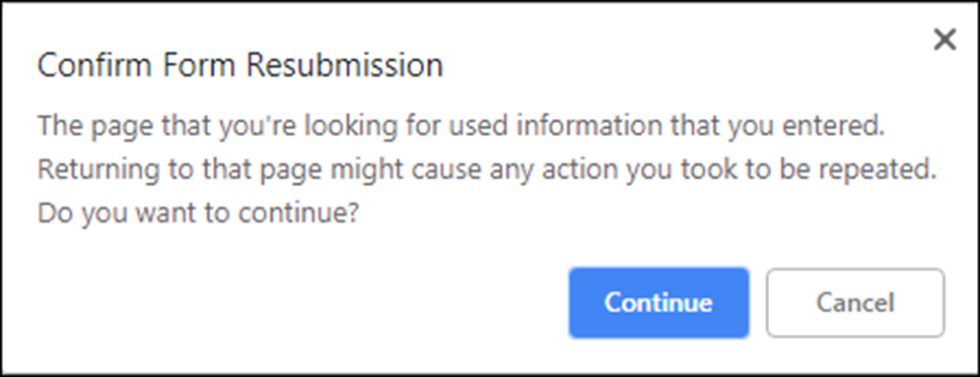
A browser message that’s displayed when you refresh a page displayed by a POST request

Slide 43
Action methods that use the PRG pattern (part 1)
A Delete() action method for a POST request
[HttpPost] // Post
public IActionResult Delete(Movie movie)
{
context.Movies.Remove(movie);
context.SaveChanges();
return RedirectToAction("Index", "Home"); // Redirect
}

Slide 44
Action methods that use the PRG pattern (part 2)
The Index() action method of the Home controller for a GET request
[HttpGet] // Get
public IActionResult Index()
{
var movies = context.Movies
.Include(m => m.Genre)
.OrderBy(m => m.Name)
.ToList();
return View(movies);
}

Slide 45
An action method that uses TempData with the PRG pattern
[HttpPost]
public IActionResult Delete(Movie movie)
{
context.Movies.Remove(movie);
context.SaveChanges();
TempData["message"] =
$"{movie.Name} deleted from database.";
return RedirectToAction("Index", "Home");
}

Slide 46
Code that reads a TempData value in a Layout view
...
<header class="jumbotron">
<h1>My Movies</h1>
</header>...
@if (TempData.Keys.Contains("message"))
{
<h4 class="bg-info text-center text-white p-2">
@TempData["message"]
</h4>
}
...

Slide 47
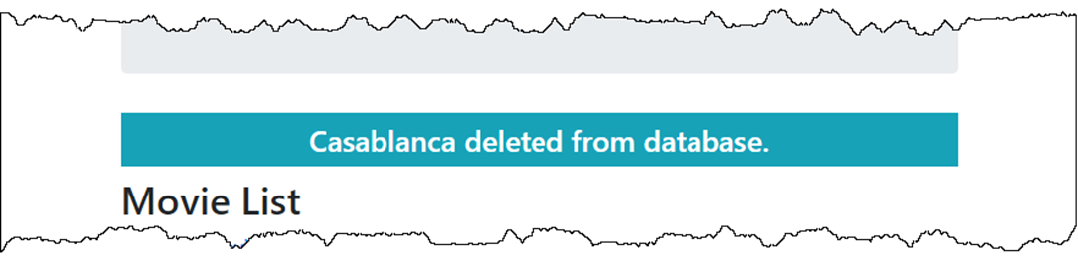
The temporary message displayed in a browser

Slide 48
Two methods of the TempDataDictionary class
Keep()
Keep(key)
Peek(key)

Slide 49
The overloaded Details() action method of the Home controller (part 1)
[HttpPost]
public RedirectToActionResult Details(TeamViewModel model)
{
Utility.LogTeamClick(model.Team.TeamID);
TempData["ActiveConf"] = model.ActiveConf;
TempData["ActiveDiv"] = model.ActiveDiv;
return RedirectToAction("Details",
new { ID = model.Team.TeamID });
}

Slide 50
The overloaded Details() action method of the Home controller (part 2)
[HttpGet]
public ViewResult Details(string id)
{
Utility.LogTeamClick(model.Team.TeamID);
var model = new TeamViewModel {
Team = context.Teams
.Include(t => t.Conference)
.Include(t => t.Division)
.FirstOrDefault(t => t.TeamID == id),
ActiveConf = TempData.Peek("ActiveConf").ToString(),
ActiveDiv = TempData.Peek("ActiveDiv").ToString()
};
return View(model);
}

Slide 51
When to use the Keep() and Peek() methods
Use Peek() when you know you want the value to stay marked as unread.
Use a normal read and Keep() when you want to use a condition to determine whether to mark the value as unread.

Slide 52
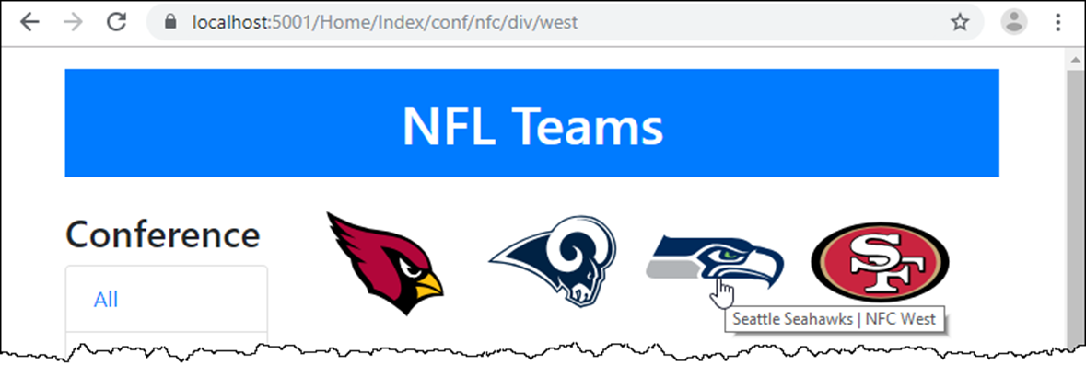
The Home page after selecting a conference and division

Slide 53
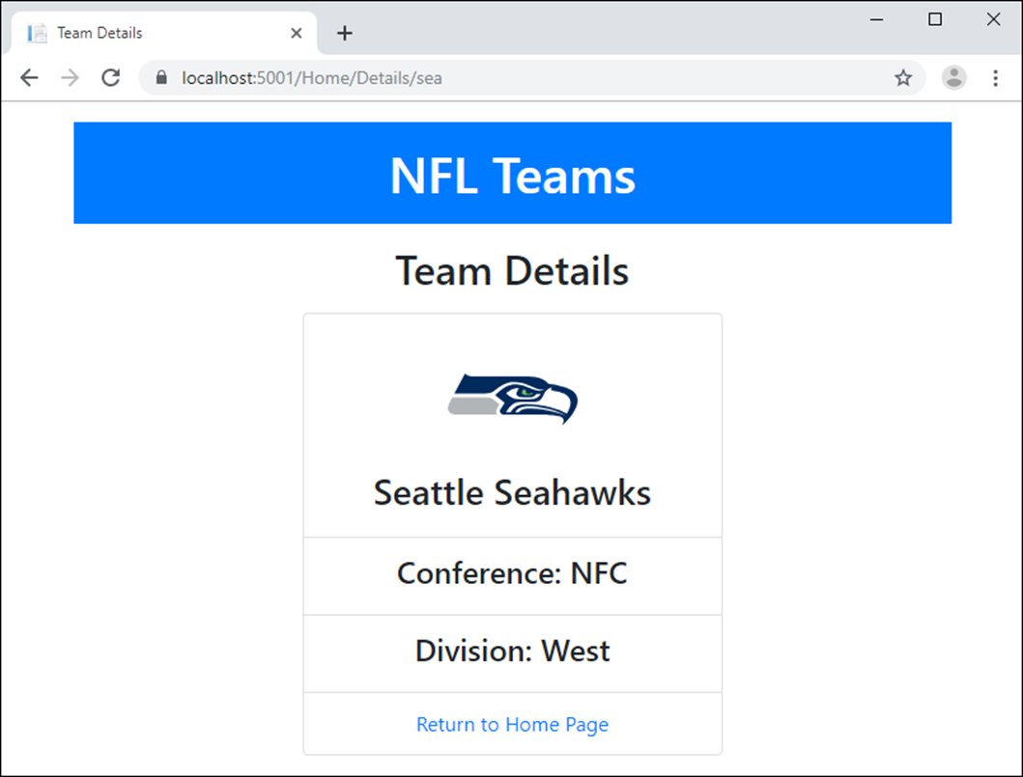
The Details page after clicking on a team

Slide 54
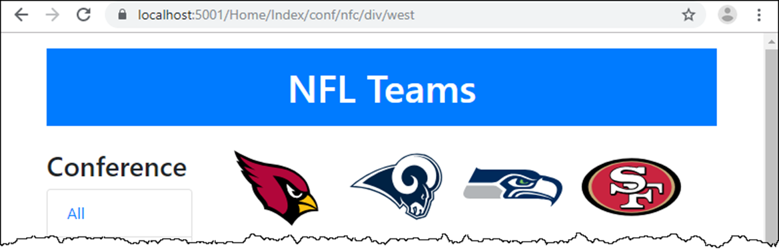
The Home page after clicking on the “Return to Home Page” link

Slide 55
The TeamViewModel class
public class TeamViewModel
{
public Team Team { get; set; }
public string ActiveConf { get; set; } = "all";
public string ActiveDiv { get; set; } = "all";
}
The updated TeamListViewModel class
public class TeamListViewModel : TeamViewModel
{
// Team, ActiveConf, and ActiveDiv properties are inherited
// Teams, Conferences, and Divisions properties same as
// figure 8-10
// CheckActiveConf() and CheckActiveDiv() methods same as
// figure 8-10
}

Slide 56
The Details() action method of the Home controller (part 1)
[HttpPost]
public RedirectToActionResult Details(TeamViewModel model)
{
Utility.LogTeamClick(model.Team.TeamID);
TempData["ActiveConf"] = model.ActiveConf;
TempData["ActiveDiv"] = model.ActiveDiv;
return RedirectToAction("Details",
new { ID = model.Team.TeamID });
}

Slide 57
The Details() action method of the Home controller (part 2)
[HttpGet]
public ViewResult Details(string id)
{
var model = new TeamViewModel
{
Team = context.Teams
.Include(t => t.Conference)
.Include(t => t.Division)
.FirstOrDefault(t => t.TeamID == id),
ActiveDiv = TempData?["ActiveDiv"]?.ToString() ?? "all",
ActiveConf = TempData?["ActiveConf"]?.ToString() ?? "all"
};
return View(model);
}

Slide 58
The Home/Index view (NFL Teams 2.0) (part 1)
@model TeamListViewModel
@{
ViewData["Title"] = "NFL Teams";
}
<div class="row">
<div class="col-sm-3">
<!-- Conference and Division ul elements -->
</div>
<div class="col-sm-9">
<ul class="list-inline">
@foreach (Team team in Model.Teams)
{
<li class="list-inline-item">
<form asp-action="Details" method="post">
<button class="bg-white border-0“
type="submit">
<img src="~/images/@team.LogoImage"
alt="@team.Name"
title="@team.Name |
@team.Conference.Name
@team.Division.Name" />
</button>

Slide 59
The Home/Index view (NFL Teams 2.0) (part 2)
<input type="hidden" asp-for="@team.TeamID" />
<input type="hidden" asp-for="ActiveConf" />
<input type="hidden" asp-for="ActiveDiv" />
</form>
</li>
}
</ul>
</div>
</div>

Slide 60
The Home/Details view (part 1)
@model TeamViewModel
@{
ViewData["Title"] = "Team Details";
}
<h2>Team Details</h2>
<div class="row">
<div class="col-sm-6 col-sm-offset-3">
<ul class="list-group text-center">
<li class="list-group-item">
<img src="~/images/@Model.Team.LogoImage" alt="" />
<h3>@Model.Team.Name</h3>
</li>
<li class="list-group-item">
<h4>Conference: @Model.Team.Conference.Name</h4>
</li>
<li class="list-group-item">
<h4>Division: @Model.Team.Division.Name</h4>
</li>

Slide 61
The Home/Details view (part 2)
<li class="list-group-item">
<a asp-action="Index"
asp-route-conference="@Model.ActiveConf"
asp-route-division="@Model.ActiveDiv">
Return to Home Page
</a>
</li>
</ul>
</div>
</div>

